Slide 1
Point du 25/05/2025
Gaël Mariot
Temps alloué: 10min/personne

Slide 2
Réalisations semaine passée
Planning
Recherches sur les bobines
Simulation CST

Slide 3
Elaboration du Planning – Partie 1
 | Mai |  |  |  |  |  |  |  |  |  |  |  |  |  |  |  |  |  |  |  | Juin |  |  |  |  |  |  |  |  |  |  |  |  |  |  |  |  |  |  |  |  |  |  |  |  |  |  |  |  |  | Juillet |  |  |  |  |  |  |  |  |  |  |  |  |  |  |  |  |  |  |  |  |  |  |  |  |  |  |  |  |  |  | Août |  |  |  |  |  |  |  |  |  |  |  |  |  |  |  |  |  |  |  |  |  |  |  |  |  |  |  |  |  |  | septembre
 | 12 | 13 | 14 | 15 | 16 | 17 | 18 | 19 | 20 | 21 | 22 | 23 | 24 | 25 | 26 | 27 | 28 | 29 | 30 | 31 | 01 | 02 | 03 | 04 | 05 | 06 | 07 | 08 | 09 | 10 | 11 | 12 | 13 | 14 | 15 | 16 | 17 | 18 | 19 | 20 | 21 | 22 | 23 | 24 | 25 | 26 | 27 | 28 | 29 | 30 | 01 | 02 | 03 | 04 | 05 | 06 | 07 | 08 | 09 | 10 | 11 | 12 | 13 | 14 | 15 | 16 | 17 | 18 | 19 | 20 | 21 | 22 | 23 | 24 | 25 | 26 | 27 | 28 | 29 | 30 | 31 | 01 | 02 | 03 | 04 | 05 | 06 | 07 | 08 | 09 | 10 | 11 | 12 | 13 | 14 | 15 | 16 | 17 | 18 | 19 | 20 | 21 | 22 | 23 | 24 | 25 | 26 | 27 | 28 | 29 | 30 | 31 | 01 | 02 | 03 | 04
Préparer planning | n | n | n | n | n | n | n | x | x | x | x | x | x | x | x |  |  |  |  |  |  |  |  |  |  |  |  |  |  |  |  |  |  |  |  |  |  |  |  |  |  |  |  |  |  |  |  |  |  |  |  |  |  |  |  |  |  |  |  |  |  |  |  |  |  |  |  | n | n | n | n | n | n | n | n | n | n
Tests CST - bob. linéaires | n | n | n | n | n | n | n |  |  |  |  |  |  | x | x | x | x | x | x | x | x |  |  |  |  |  |  |  |  |  |  |  |  |  |  |  |  |  |  |  |  |  |  |  |  |  |  |  |  |  |  |  |  |  |  |  |  |  |  |  |  |  |  |  |  |  |  | n | n | n | n | n | n | n | n | n | n
Tests Physique - bob. linéaire | n | n | n | n | n | n | n |  |  |  |  |  |  |  | x | x | x | x | x | x | x | x | x | x |  |  |  |  |  |  |  |  |  |  |  |  |  |  |  |  |  |  |  |  |  |  |  |  |  |  |  |  |  |  |  |  |  |  |  |  |  |  |  |  |  |  |  | n | n | n | n | n | n | n | n | n | n
Rech. Tech. Pilotage | n | n | n | n | n | n | n |  |  |  |  |  |  | x | x | x | x | x | x | x | x | x | x | x | x | x | x | x |  |  |  |  |  |  |  |  |  |  |  |  |  |  |  |  |  |  |  |  |  |  |  |  |  |  |  |  |  |  |  |  |  |  |  |  |  |  |  | n | n | n | n | n | n | n | n | n | n
Rech. MCU | n | n | n | n | n | n | n |  |  |  |  |  |  |  |  |  |  |  |  |  |  |  |  |  | x | x | x | x | x | x | x | x | x | x | x |  |  |  |  |  |  |  |  |  |  |  |  |  |  |  |  |  |  |  |  |  |  |  |  |  |  |  |  |  |  |  |  | n | n | n | n | n | n | n | n | n | n
Prototype 1 | n | n | n | n | n | n | n |  |  |  |  |  |  |  |  |  |  |  |  |  |  |  |  |  |  |  |  |  |  |  |  |  |  | x | x | x | x | x | x | x | x | x | x | x | x | x | x | x | x |  | x | x | x | x |  |  |  |  |  |  |  |  |  |  |  |  |  | n | n | n | n | n | n | n | n | n | n
Recherche Composants | n | n | n | n | n | n | n |  |  |  |  |  |  |  |  |  |  |  |  |  |  |  |  |  |  |  |  |  |  |  |  |  |  | x | x | x | x | x | x | x | x | x |  |  |  |  |  |  |  |  |  |  |  |  |  |  |  |  |  |  |  |  |  |  |  |  |  | n | n | n | n | n | n | n | n | n | n
Schematique | n | n | n | n | n | n | n |  |  |  |  |  |  |  |  |  |  |  |  |  |  |  |  |  |  |  |  |  |  |  |  |  |  |  |  |  |  |  |  |  |  |  | x | x | x | x | x |  |  |  |  |  |  |  |  |  |  |  |  |  |  |  |  |  |  |  |  | n | n | n | n | n | n | n | n | n | n
Design | n | n | n | n | n | n | n |  |  |  |  |  |  |  |  |  |  |  |  |  |  |  |  |  |  |  |  |  |  |  |  |  |  |  |  |  |  |  |  |  |  |  |  |  |  |  |  | x | x |  | x |  |  |  |  |  |  |  |  |  |  |  |  |  |  |  |  | n | n | n | n | n | n | n | n | n | n
Assemblage | n | n | n | n | n | n | n |  |  |  |  |  |  |  |  |  |  |  |  |  |  |  |  |  |  |  |  |  |  |  |  |  |  |  |  |  |  |  |  |  |  |  |  |  |  |  |  |  |  |  |  | x | x |  |  |  |  |  |  |  |  |  |  |  |  |  |  | n | n | n | n | n | n | n | n | n | n
Tests | n | n | n | n | n | n | n |  |  |  |  |  |  |  |  |  |  |  |  |  |  |  |  |  |  |  |  |  |  |  |  |  |  |  |  |  |  |  |  |  |  |  |  |  |  |  |  |  |  |  |  |  |  | x |  |  |  |  |  |  |  |  |  |  |  |  |  | n | n | n | n | n | n | n | n | n | n
Prototype 2 | n | n | n | n | n | n | n |  |  |  |  |  |  |  |  |  |  |  |  |  |  |  |  |  |  |  |  |  |  |  |  |  |  |  |  |  |  |  |  |  |  |  |  |  |  |  |  |  |  |  |  |  |  |  | x | x | x | x | x | x | x | x | x | x | x | x | x | n | n | n | n | n | n | n | n | n | n
Recherche Composants | n | n | n | n | n | n | n |  |  |  |  |  |  |  |  |  |  |  |  |  |  |  |  |  |  |  |  |  |  |  |  |  |  |  |  |  |  |  |  |  |  |  |  |  |  |  |  |  |  |  |  |  |  |  | x | x | x | x |  |  |  |  |  |  |  |  |  | n | n | n | n | n | n | n | n | n | n
Schematique | n | n | n | n | n | n | n |  |  |  |  |  |  |  |  |  |  |  |  |  |  |  |  |  |  |  |  |  |  |  |  |  |  |  |  |  |  |  |  |  |  |  |  |  |  |  |  |  |  |  |  |  |  |  |  |  |  |  | x | x | x |  |  |  |  |  |  | n | n | n | n | n | n | n | n | n | n
Design | n | n | n | n | n | n | n |  |  |  |  |  |  |  |  |  |  |  |  |  |  |  |  |  |  |  |  |  |  |  |  |  |  |  |  |  |  |  |  |  |  |  |  |  |  |  |  |  |  |  |  |  |  |  |  |  |  |  |  |  |  | x | x | x |  |  |  | n | n | n | n | n | n | n | n | n | n
Assemblage | n | n | n | n | n | n | n |  |  |  |  |  |  |  |  |  |  |  |  |  |  |  |  |  |  |  |  |  |  |  |  |  |  |  |  |  |  |  |  |  |  |  |  |  |  |  |  |  |  |  |  |  |  |  |  |  |  |  |  |  |  |  |  |  | x | x |  | n | n | n | n | n | n | n | n | n | n
Tests | n | n | n | n | n | n | n |  |  |  |  |  |  |  |  |  |  |  |  |  |  |  |  |  |  |  |  |  |  |  |  |  |  |  |  |  |  |  |  |  |  |  |  |  |  |  |  |  |  |  |  |  |  |  |  |  |  |  |  |  |  |  |  |  |  |  | x | n | n | n | n | n | n | n | n | n | n
Proto Final | n | n | n | n | n | n | n |  |  |  |  |  |  |  |  |  |  |  |  |  |  |  |  |  |  |  |  |  |  |  |  |  |  |  |  |  |  |  |  |  |  |  |  |  |  |  |  |  |  |  |  |  |  |  |  |  |  |  |  |  |  |  |  |  |  |  |  | n | n | n | n | n | n | n | n | n | n | x | x | x | x | x | x | x | x | x | x | x | x | x | x | x | x | x | x | x | x | x | x | x | x |  |  |  |  |  |  | x |  |  |  |  |  | x
Recherche Composants | n | n | n | n | n | n | n |  |  |  |  |  |  |  |  |  |  |  |  |  |  |  |  |  |  |  |  |  |  |  |  |  |  |  |  |  |  |  |  |  |  |  |  |  |  |  |  |  |  |  |  |  |  |  |  |  |  |  |  |  |  |  |  |  |  |  |  | n | n | n | n | n | n | n | n | n | n | x | x | x | x | x | x | x | x
Schematique | n | n | n | n | n | n | n |  |  |  |  |  |  |  |  |  |  |  |  |  |  |  |  |  |  |  |  |  |  |  |  |  |  |  |  |  |  |  |  |  |  |  |  |  |  |  |  |  |  |  |  |  |  |  |  |  |  |  |  |  |  |  |  |  |  |  |  | n | n | n | n | n | n | n | n | n | n |  |  |  |  |  |  |  |  | x | x | x | x | x |  |  |  |  |  |  |  |  |  |  | x
Design | n | n | n | n | n | n | n |  |  |  |  |  |  |  |  |  |  |  |  |  |  |  |  |  |  |  |  |  |  |  |  |  |  |  |  |  |  |  |  |  |  |  |  |  |  |  |  |  |  |  |  |  |  |  |  |  |  |  |  |  |  |  |  |  |  |  |  | n | n | n | n | n | n | n | n | n | n |  |  |  |  |  |  |  |  |  |  |  |  |  | x | x | x | x | x |  |  |  |  |  |  |  |  |  |  |  |  | x
Assemblage | n | n | n | n | n | n | n |  |  |  |  |  |  |  |  |  |  |  |  |  |  |  |  |  |  |  |  |  |  |  |  |  |  |  |  |  |  |  |  |  |  |  |  |  |  |  |  |  |  |  |  |  |  |  |  |  |  |  |  |  |  |  |  |  |  |  |  | n | n | n | n | n | n | n | n | n | n |  |  |  |  |  |  |  |  |  |  |  |  |  |  |  |  |  |  | x | x | x |  |  |  |  |  |  |  |  |  |  |  |  |  |  |  | x
Tests | n | n | n | n | n | n | n |  |  |  |  |  |  |  |  |  |  |  |  |  |  |  |  |  |  |  |  |  |  |  |  |  |  |  |  |  |  |  |  |  |  |  |  |  |  |  |  |  |  |  |  |  |  |  |  |  |  |  |  |  |  |  |  |  |  |  |  | n | n | n | n | n | n | n | n | n | n |  |  |  |  |  |  |  |  |  |  |  |  |  |  |  |  |  |  |  |  |  | x | x
Rendu | n | n | n | n | n | n | n |  |  |  |  |  |  |  |  |  |  |  |  |  |  |  |  |  |  |  |  |  |  |  |  |  |  |  |  |  |  |  |  |  |  |  |  |  |  |  |  |  |  | x |  |  |  |  |  |  |  |  |  |  |  |  |  |  |  |  |  | n | n | n | n | n | n | n | n | n | n |  |  |  |  |  |  |  |  |  |  |  |  |  |  |  |  |  |  |  |  |  |  |  | x |  |  |  |  |  |  | x |  |  |  |  |  | x
Rapport Intermediaire | n | n | n | n | n | n | n |  |  |  |  |  |  |  |  |  |  |  |  |  |  |  |  |  |  |  |  |  |  |  |  |  |  |  |  |  |  |  |  |  |  |  |  |  |  |  |  |  |  | x |  |  |  |  |  |  |  |  |  |  |  |  |  |  |  |  |  | n | n | n | n | n | n | n | n | n | n
Rapport Final | n | n | n | n | n | n | n |  |  |  |  |  |  |  |  |  |  |  |  |  |  |  |  |  |  |  |  |  |  |  |  |  |  |  |  |  |  |  |  |  |  |  |  |  |  |  |  |  |  |  |  |  |  |  |  |  |  |  |  |  |  |  |  |  |  |  |  | n | n | n | n | n | n | n | n | n | n |  |  |  |  |  |  |  |  |  |  |  |  |  |  |  |  |  |  |  |  |  |  |  | x
Poster + Diapo | n | n | n | n | n | n | n |  |  |  |  |  |  |  |  |  |  |  |  |  |  |  |  |  |  |  |  |  |  |  |  |  |  |  |  |  |  |  |  |  |  |  |  |  |  |  |  |  |  |  |  |  |  |  |  |  |  |  |  |  |  |  |  |  |  |  |  | n | n | n | n | n | n | n | n | n | n |  |  |  |  |  |  |  |  |  |  |  |  |  |  |  |  |  |  |  |  |  |  |  |  |  |  |  |  |  |  | x
Défense | n | n | n | n | n | n | n |  |  |  |  |  |  |  |  |  |  |  |  |  |  |  |  |  |  |  |  |  |  |  |  |  |  |  |  |  |  |  |  |  |  |  |  |  |  |  |  |  |  |  |  |  |  |  |  |  |  |  |  |  |  |  |  |  |  |  |  | n | n | n | n | n | n | n | n | n | n |  |  |  |  |  |  |  |  |  |  |  |  |  |  |  |  |  |  |  |  |  |  |  |  |  |  |  |  |  |  |  |  |  |  |  |  | x
Préparation Défense | n | n | n | n | n | n | n |  |  |  |  |  |  |  |  |  |  |  |  |  |  |  |  |  |  |  |  |  |  |  |  |  |  |  |  |  |  |  |  |  |  |  |  |  |  |  |  |  |  |  |  |  |  |  |  |  |  |  |  |  |  |  |  |  |  |  |  | n | n | n | n | n | n | n | n | n | n |  |  |  |  |  |  |  |  |  |  |  |  |  |  |  |  |  |  |  |  |  |  |  |  | x | x | x | x | x | x |  | x | x | x | x | x

Slide 4
Elaboration du Planning – Partie 2
 | S1 |  | S2 |  | S3 |  | S4 |  | S5 |  | S6 |  | S7 |  | S8 |  | S9 |  | S10 |  | S11 |  | S12 |  | S13 |  | S14 |  | S15 |  | S16 |  | S17
 | 12/05 | 18/05 | 19/05 | 25/05 | 26/05 | 01/06 | 02/06 | 08/06 | 09/06 | 15/06 | 16/06 | 22/06 | 23/06 | 29/06 | 30/06 | 06/07 | 07/07 | 13/07 | 14/07 | 20/07 | 21/07 | 27/07 | 28/07 | 03/08 | 04/08 | 10/08 | 11/08 | 17/08 | 18/08 | 24/08 | 25/08 | 31/08 | 01/09 | 07/09
Préparer planning | n |  | x |  | x |  |  |  |  |  |  |  |  |  |  |  |  |  | n |  | n
Tests CST - bob. linéaires | n |  | x |  | x |  |  |  |  |  |  |  |  |  |  |  |  |  | n |  | n
Tests Physique - bob. linéaire | n |  |  |  | x |  | x |  |  |  |  |  |  |  |  |  |  |  | n |  | n
Rech. Tech. Pilotage | n |  | x |  | x |  | x |  |  |  |  |  |  |  |  |  |  |  | n |  | n
Rech. MCU | n |  |  |  |  |  | x |  | x |  |  |  |  |  |  |  |  |  | n |  | n
Prototype 1 | n |  |  |  |  |  |  |  | x |  | x |  | x |  | x |  |  |  | n |  | n
Recherche Composants | n |  |  |  |  |  |  |  | x |  | x |  |  |  |  |  |  |  | n |  | n
Schematique | n |  |  |  |  |  |  |  |  |  |  |  | x |  |  |  |  |  | n |  | n
Design | n |  |  |  |  |  |  |  |  |  |  |  | x |  | x |  |  |  | n |  | n
Assemblage | n |  |  |  |  |  |  |  |  |  |  |  |  |  | x |  |  |  | n |  | n
Tests | n |  |  |  |  |  |  |  |  |  |  |  |  |  | x |  |  |  | n |  | n
Prototype 2 | n |  |  |  |  |  |  |  |  |  |  |  |  |  | x |  | x |  | x |  | n
Recherche Composants | n |  |  |  |  |  |  |  |  |  |  |  |  |  | x |  | x |  | n |  | n
Schematique | n |  |  |  |  |  |  |  |  |  |  |  |  |  |  |  | x |  | n |  | n
Design | n |  |  |  |  |  |  |  |  |  |  |  |  |  |  |  | x |  | x |  | n
Assemblage | n |  |  |  |  |  |  |  |  |  |  |  |  |  |  |  |  |  | x |  | n
Tests | n |  |  |  |  |  |  |  |  |  |  |  |  |  |  |  |  |  | x |  | n
Proto Final | n |  |  |  |  |  |  |  |  |  |  |  |  |  |  |  |  |  | n |  | n |  | x |  | x |  | x |  | x |  | x |  | x
Recherche Composants | n |  |  |  |  |  |  |  |  |  |  |  |  |  |  |  |  |  | n |  | n |  | x |  | x
Schematique | n |  |  |  |  |  |  |  |  |  |  |  |  |  |  |  |  |  | n |  | n |  |  |  | x |  |  |  | x
Design | n |  |  |  |  |  |  |  |  |  |  |  |  |  |  |  |  |  | n |  | n |  |  |  | x |  | x |  |  |  | x
Assemblage | n |  |  |  |  |  |  |  |  |  |  |  |  |  |  |  |  |  | n |  | n |  |  |  |  |  | x |  |  |  |  |  | x
Tests | n |  |  |  |  |  |  |  |  |  |  |  |  |  |  |  |  |  | n |  | n |  |  |  |  |  |  |  | x
Rendu | n |  |  |  |  |  |  |  |  |  |  |  |  |  | x |  |  |  | n |  | n |  |  |  |  |  |  |  | x |  | x |  | x
Rapport Intermediaire | n |  |  |  |  |  |  |  |  |  |  |  |  |  | x |  |  |  | n |  | n
Rapport Final | n |  |  |  |  |  |  |  |  |  |  |  |  |  |  |  |  |  | n |  | n |  |  |  |  |  |  |  | x
Poster + Diapo | n |  |  |  |  |  |  |  |  |  |  |  |  |  |  |  |  |  | n |  | n |  |  |  |  |  |  |  |  |  | x
Défense | n |  |  |  |  |  |  |  |  |  |  |  |  |  |  |  |  |  | n |  | n |  |  |  |  |  |  |  |  |  |  |  | x
Préparation Défense | n |  |  |  |  |  |  |  |  |  |  |  |  |  |  |  |  |  | n |  | n |  |  |  |  |  |  |  | x |  | x |  | x

Slide 5
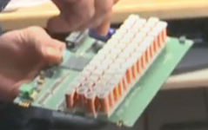
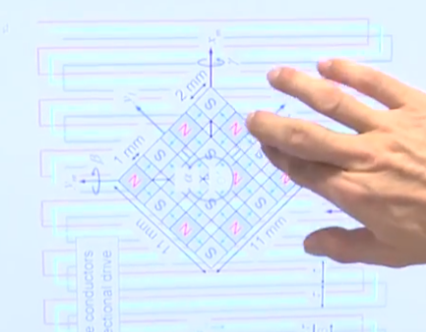
Recherches sur les bobines
Gerrits Tagebuch #45
Bobines Linéaires nécessaire pour déplacement fluide
Réseau de Hallbach

Slide 6
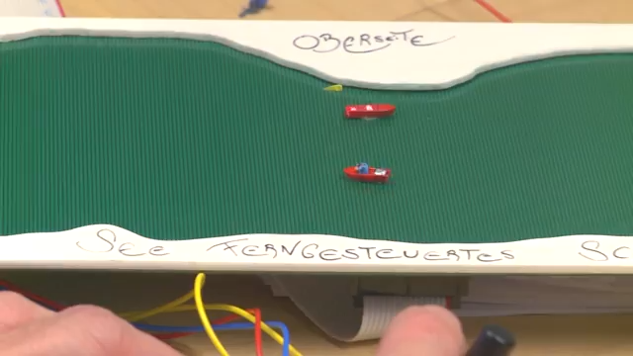
Recherche sur les bobines - Démo

Slide 7
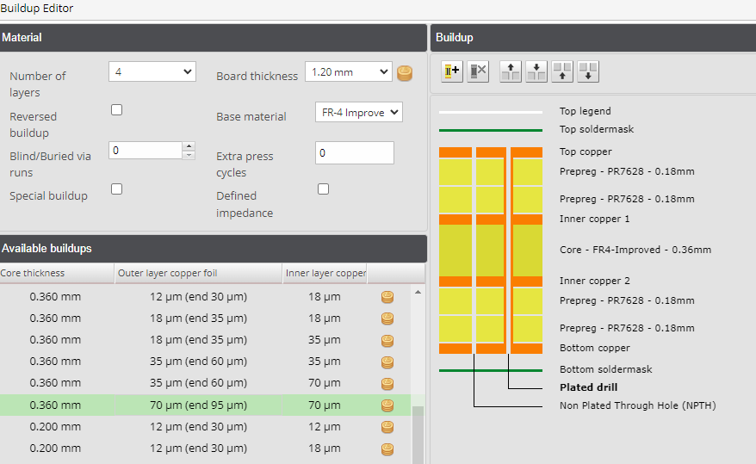
Simulation CST
Création d’un modèle similaire à MIWULA (miniatur wundereland)
Paramètres
Largeur d’un «méandre» = largeur de piste * 2 + espacement
Longueur d’un «méandre» = 50mm
Hauteur de piste : max de eurocircuits.ch (70 ⬄ 2oz)
Ampérage : 1 A
Hauteur de substrat : 0,36mm
Espacement : Largeur de piste
Largeur de piste : Calcul …

Slide 8


Simulation CST - Calcul
1 mil^2 = (0.0254mm)^2 = 0.00064516 mm^2
k,b et c définis par l’IPC-2221
b = 0.44
c = 0.725
k = 0.024 pour layers internes
k = 0.048 pour layers externes

Slide 9

Simulation CST - Calcul
Paramètres
10°C de montée en température
1Ampère
Aire = 0,447… mm^2
Largeur de piste = A/hauteur de piste = 0,260mm

Slide 10
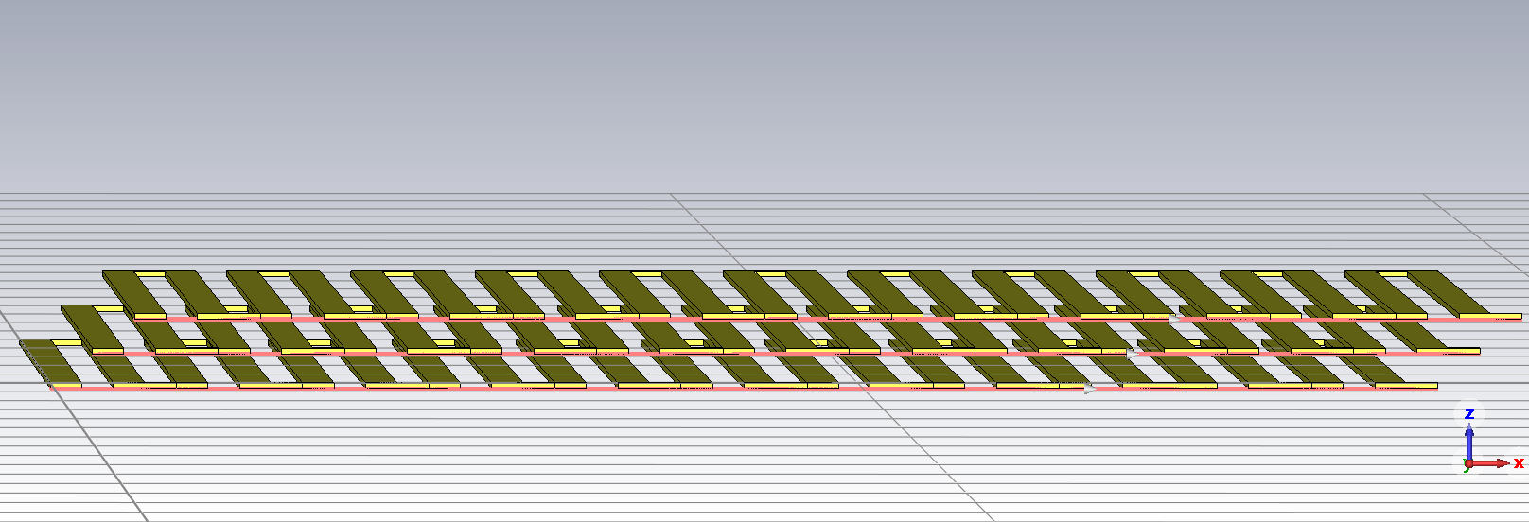
Simulation CST

Slide 11
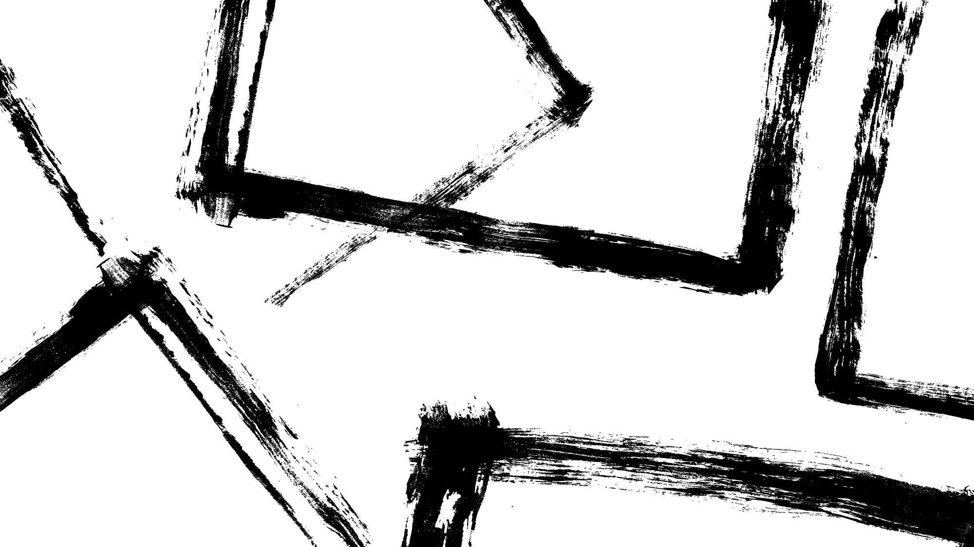
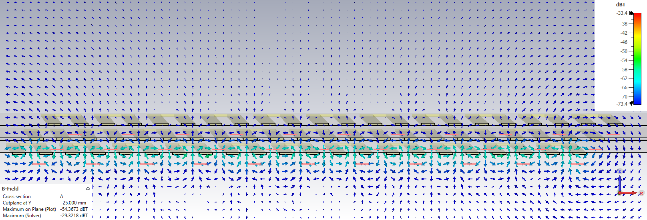
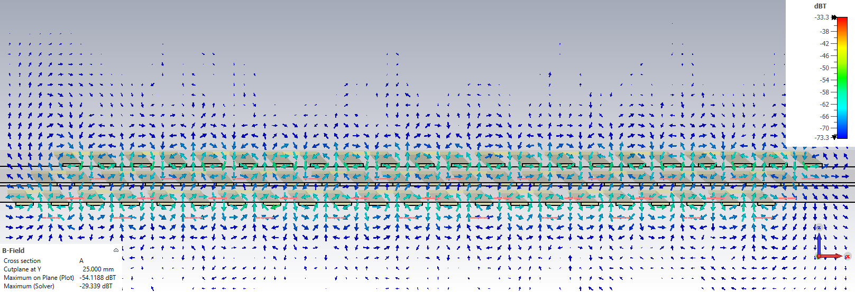
Simulation CST - Comparaison
Simulation 1
Bobine 1 : 1 Ampère
Bobine 2 : 0 Ampère
Bobine 3 : 0 Ampère
Simulation 2
Bobine 1 : 1 Ampère
Bobine 2 : 0 Ampère
Bobine 3 : -1 Ampère

Slide 12
Prévisions pour la semaine à venir
Continuer les tests sur CST
Analyse des tests sur CST
Rechercher des techniques de pilotage
Tester les bobines possédées

